Slide 1
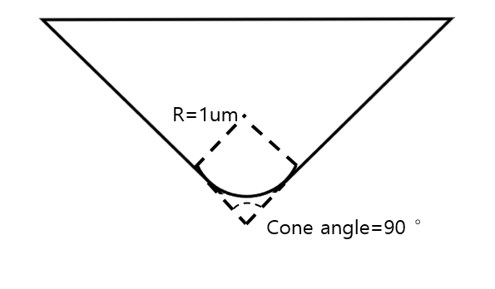
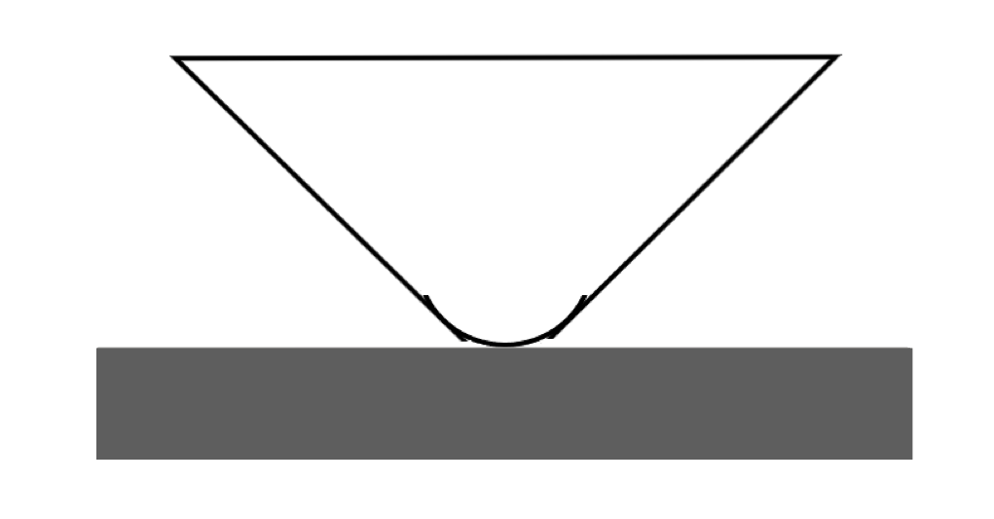

Indenter
Indenter radius: 1um
Cone Angle: 90°
Indenter
Grain
1

Slide 2
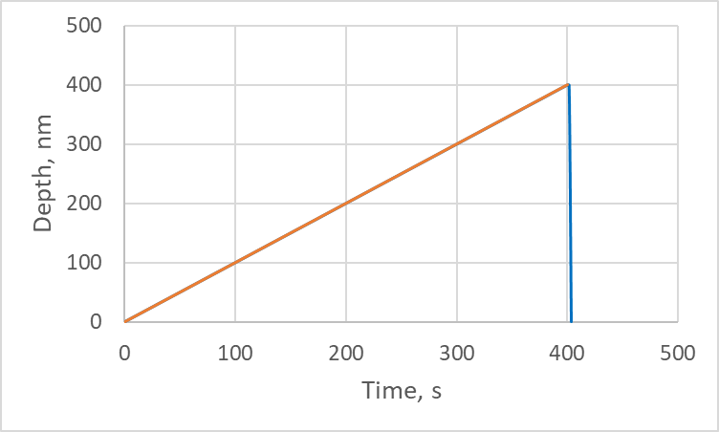
Loading function - Example
Total time: 407 s
Total penetration depth: 400 nm
Loading time: 400 s
Loading rate: 1nm/s
Holding time: 2 s
Unloading time: 5 s
Holding
Loading
Unloading
2

Slide 3
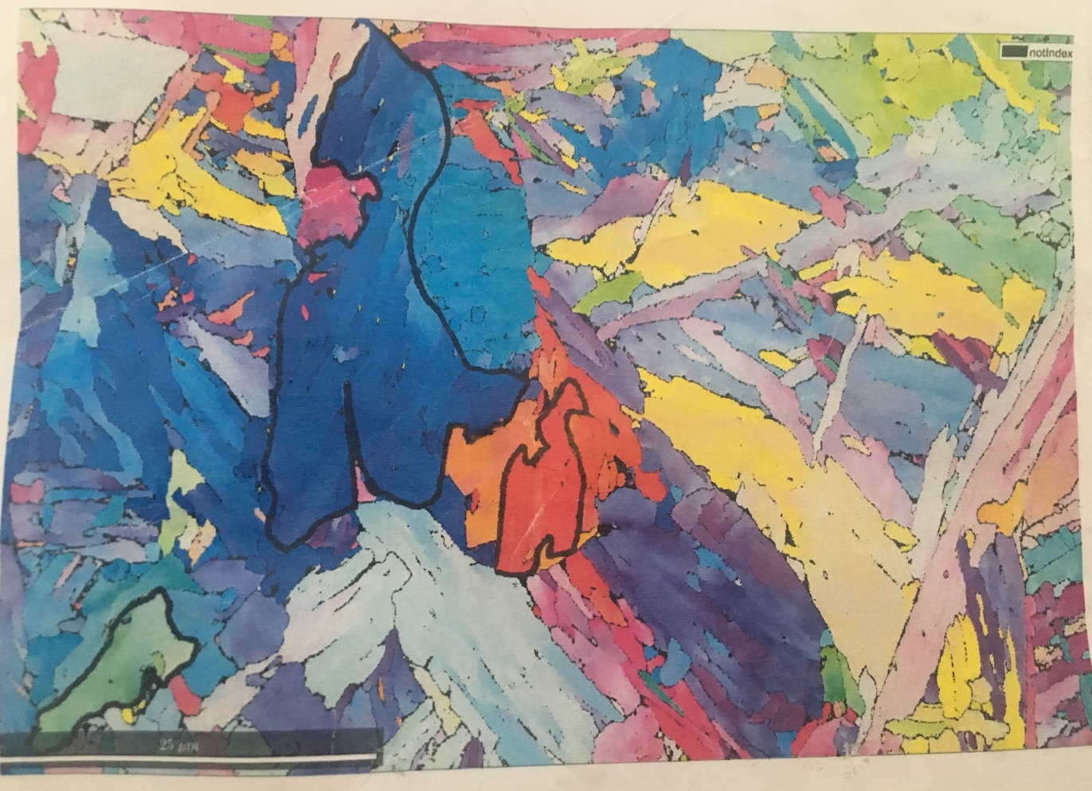
Position
Yellow
Blue
Red
Light Blue
Green
3

Slide 4
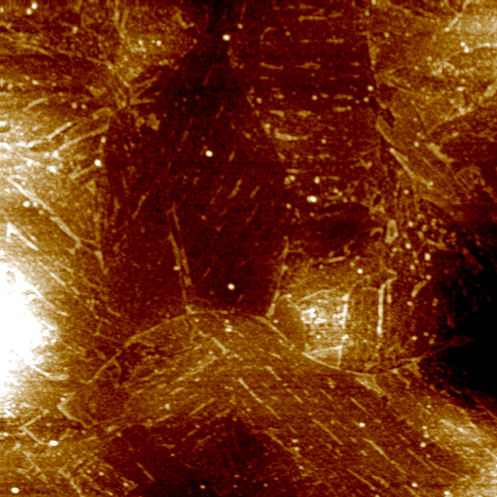
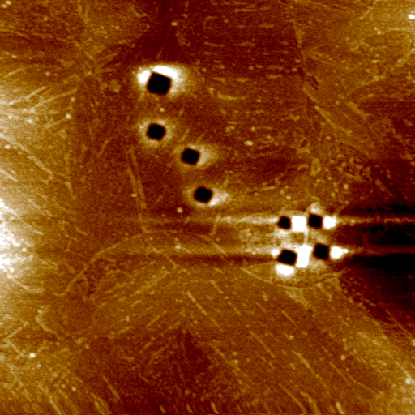
Blue grain
Before test
After test
1
2
3
10um
10um
4

Slide 5
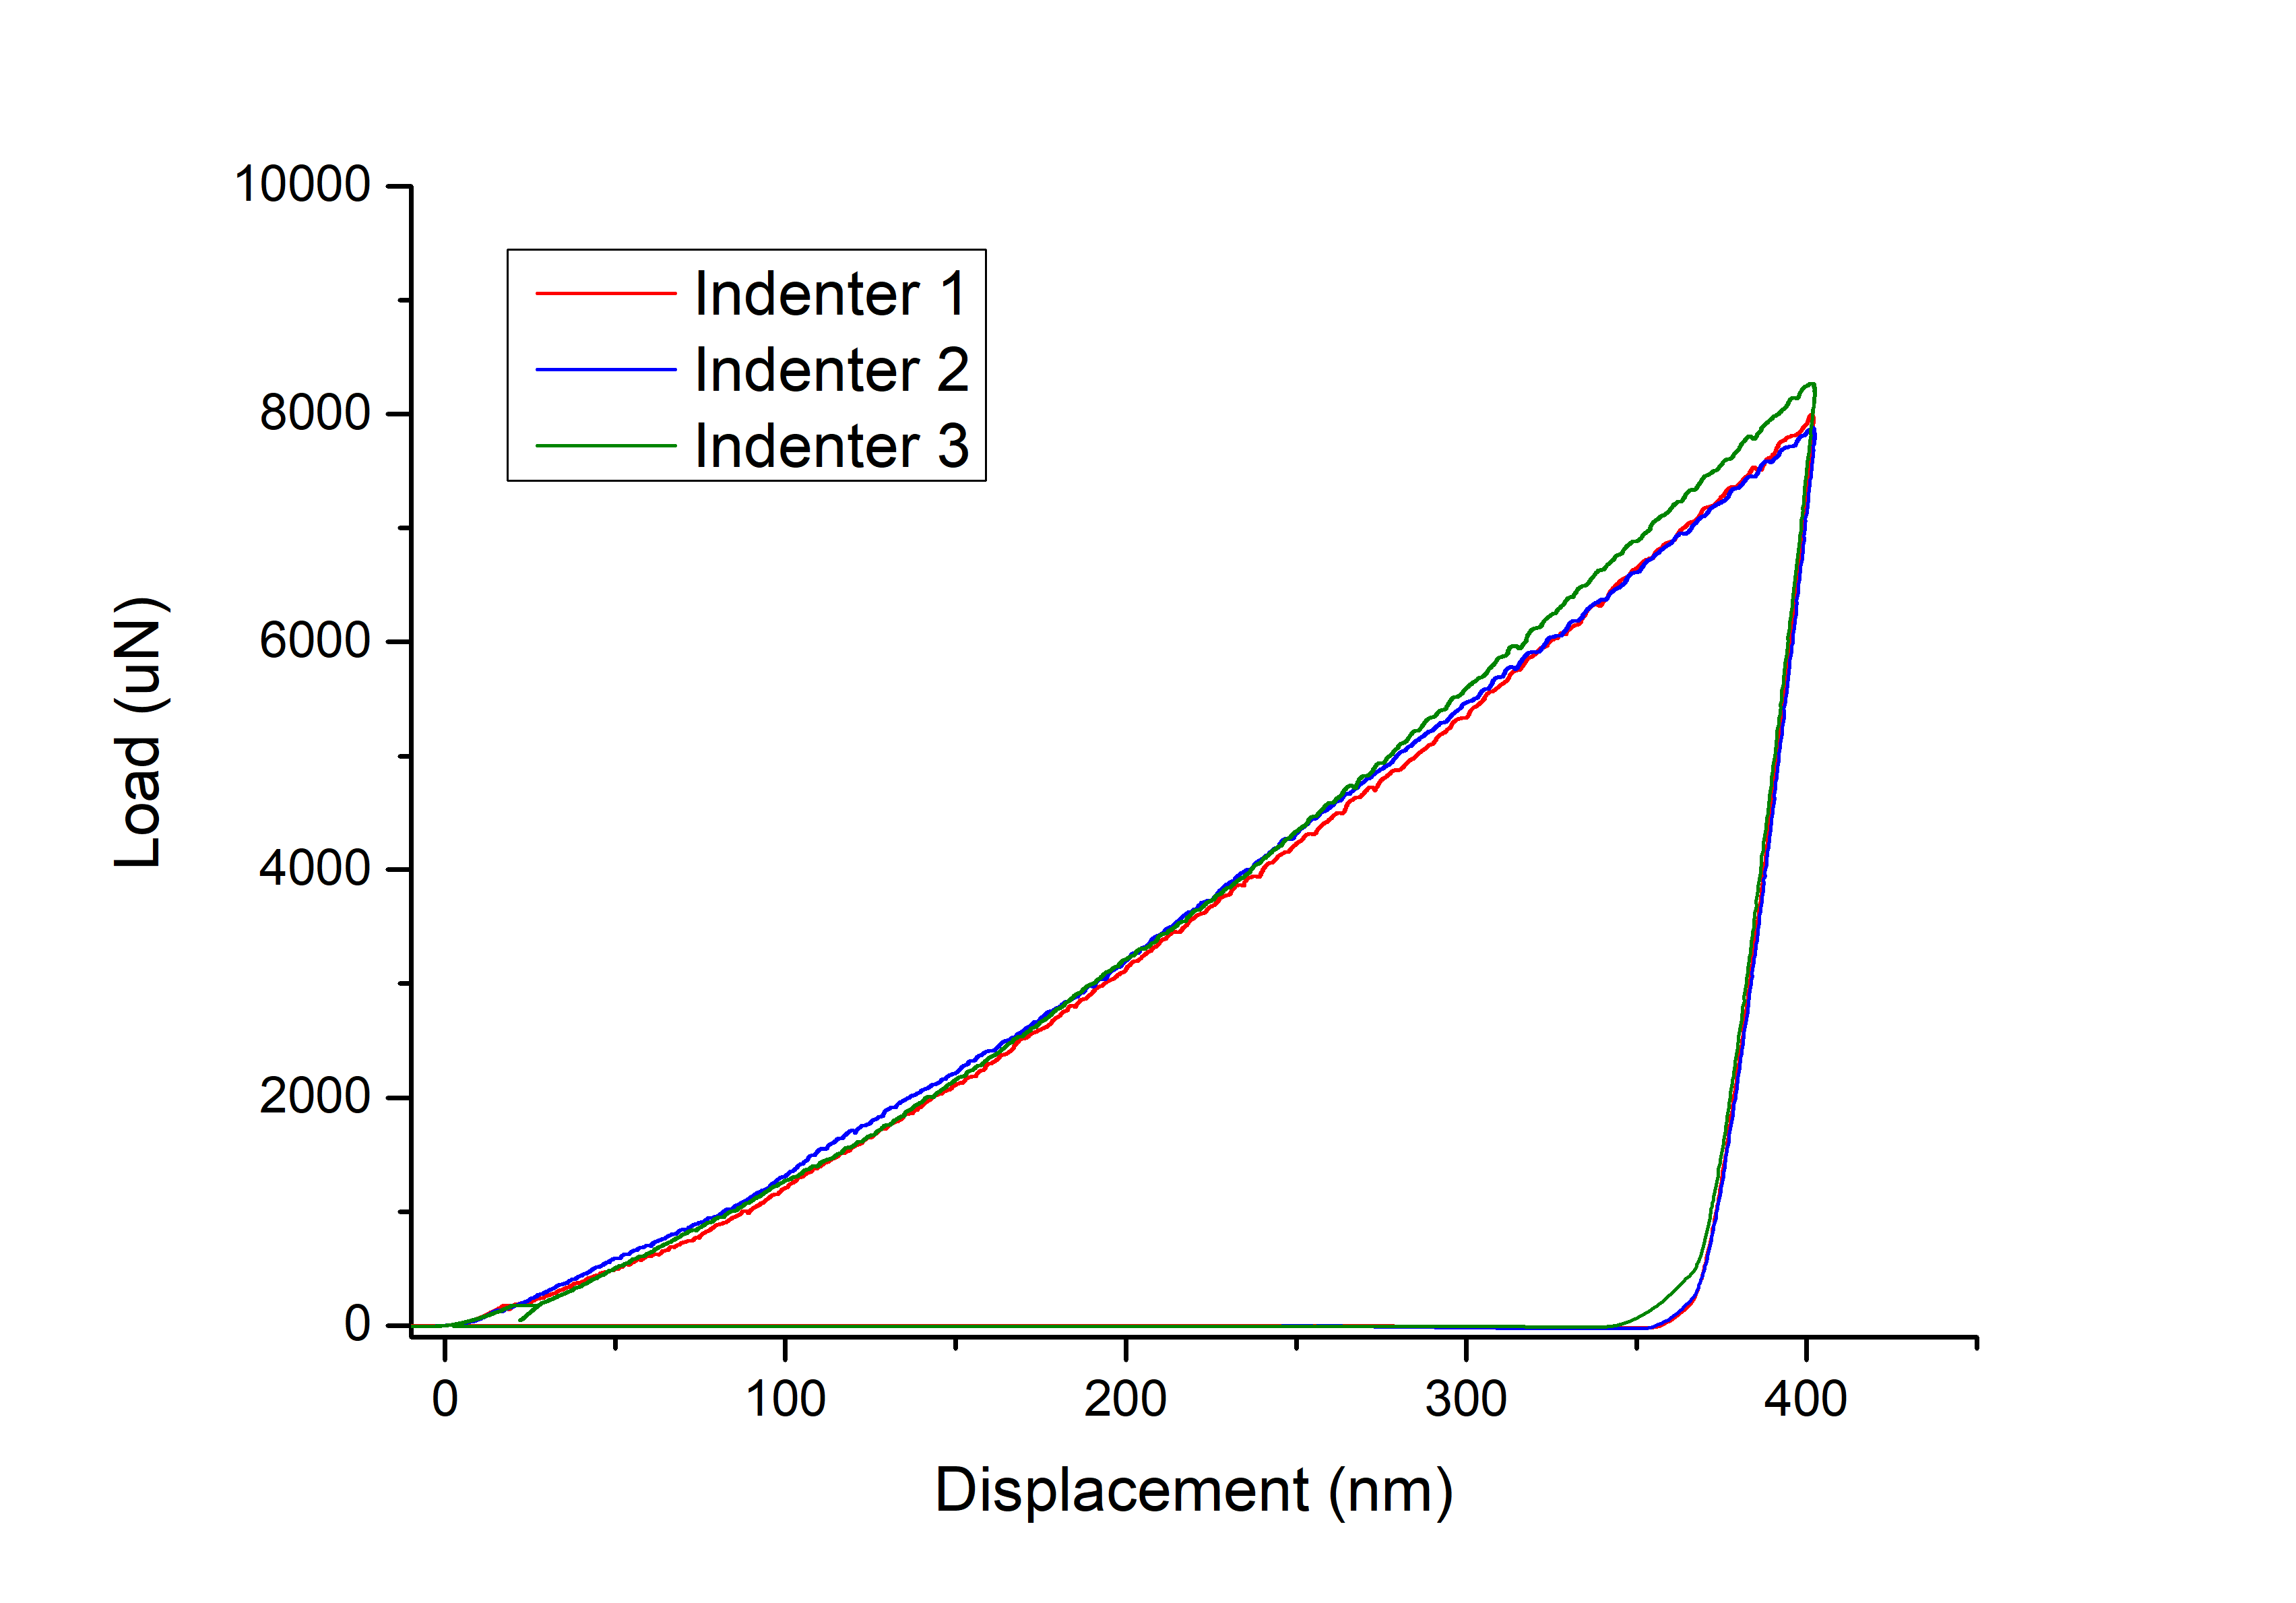
Blue grain
1
2
3
4
5

Slide 6
Red grain
Before test
After test
1
3
2
4
10um
10um
6

Slide 7
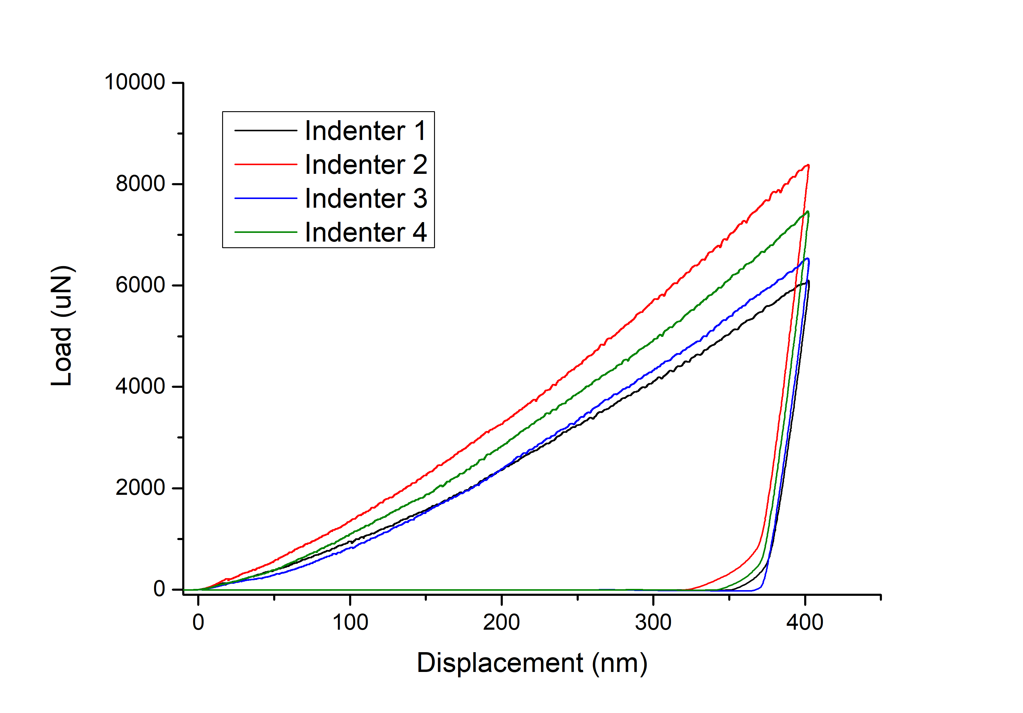
Red grain
1
2
3
4
7

Slide 8
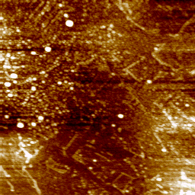
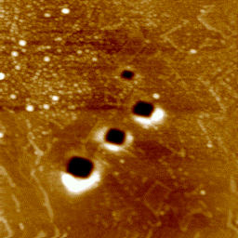
Green grain
Before test
After test
1
2
3
4
5um
5um
8

Slide 9
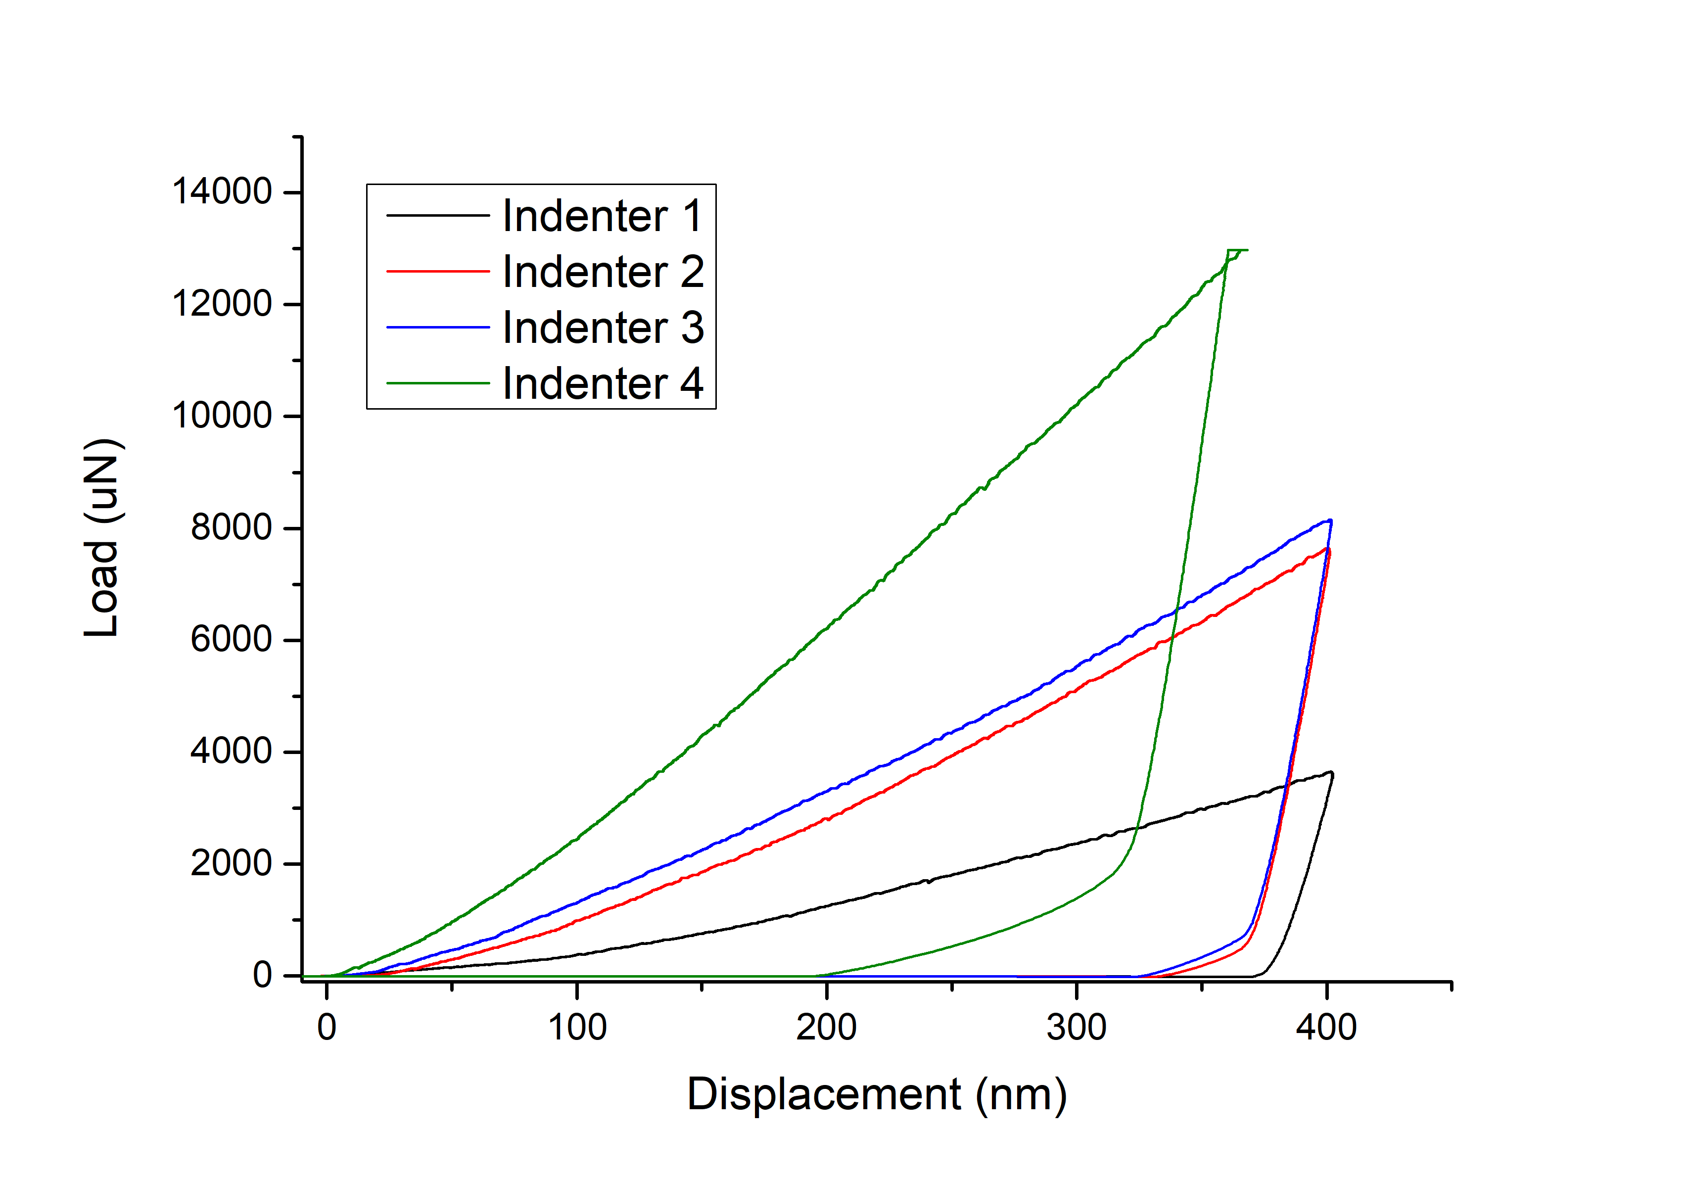
Green grain
1
2
3
4
The indentation tests 2,3,4 in green grain are deviate from the desired position,
The result of Indenter 1 should be reliable.
9

Slide 10
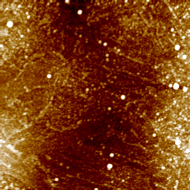
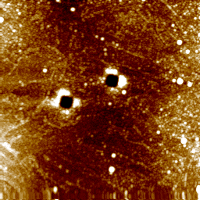
Yellow grain
Before test
After test
1
2
2
3
1
4
5um
5um
5um
5um
10

Slide 11
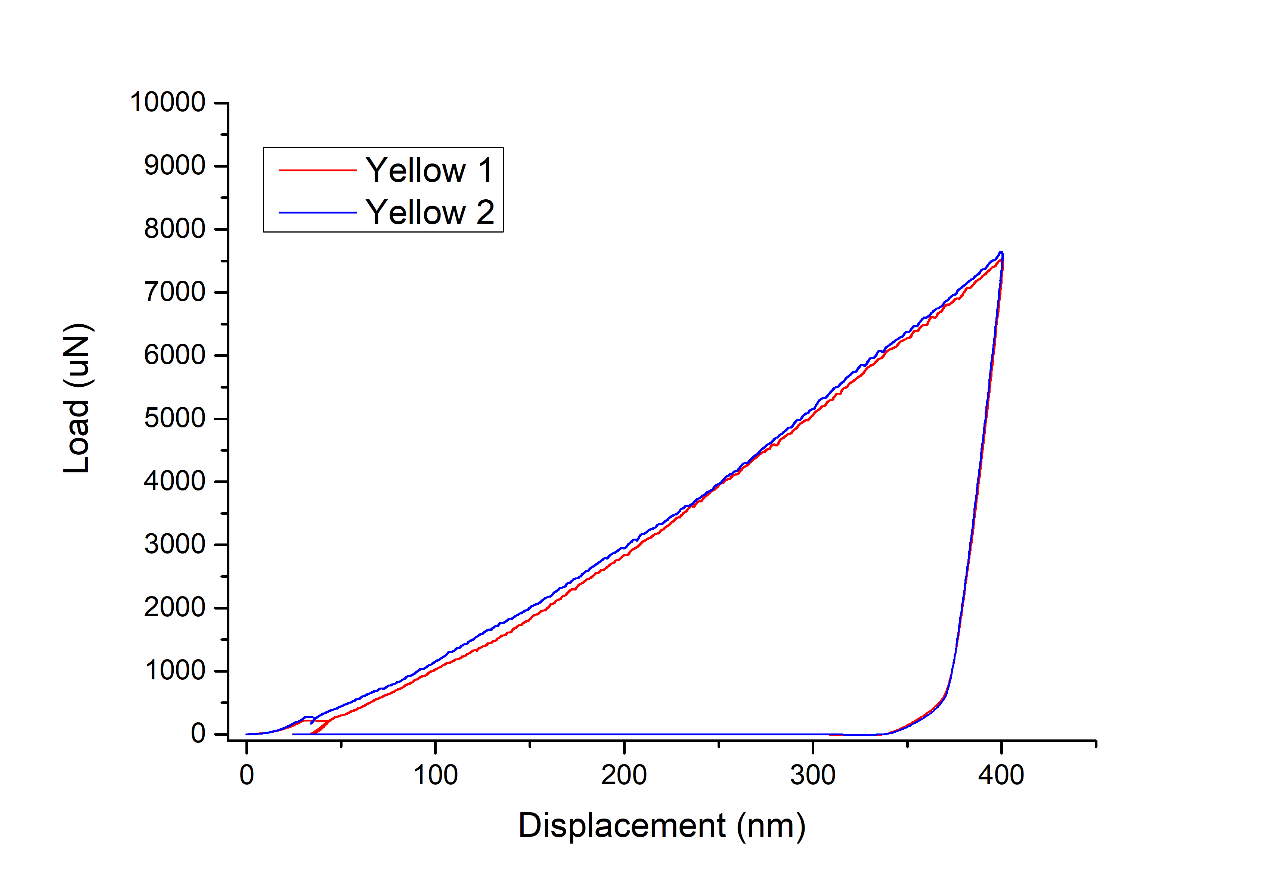
Yellow grain
1
2
2
3
1
4
5um
5um
5um
5um
11

Slide 12
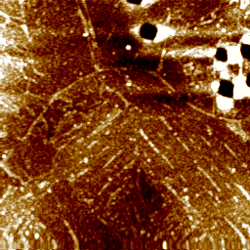
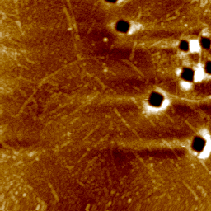
Light Blue grain
Before test
After test
1
2
5um
5um
12

Slide 13
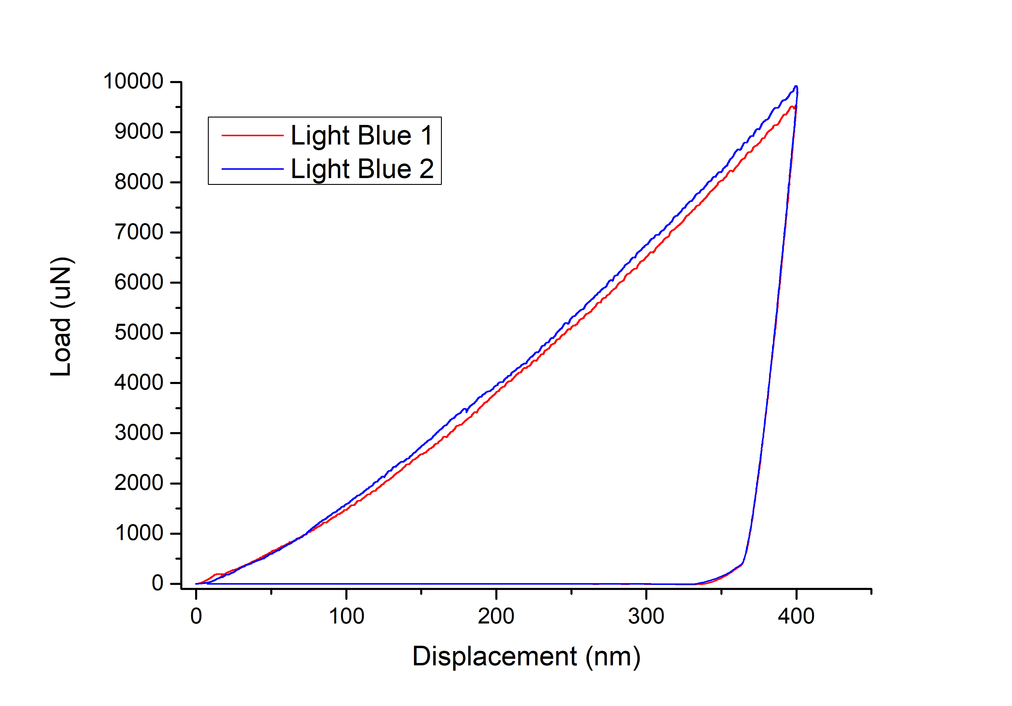
Light Blue grain
1
2
2
3
1
4
5um
5um
5um
5um
13

